Slide 1
DriveRight® 600
User’s Guide

Slide 2
INTRODUCTION TO THE DRIVERIGHT 600
The DriveRight 600, in conjunction with the DriveRight Vehicle Management Software, provides advanced vehicle safety and use monitoring capabilities as well as comprehensive fleet management capabilities. This manual explains how to use the DriveRight 600 display unit to view information.
NOTE: Altering the DriveRight 600’s limits, deleting trip information, and calibrating the DriveRight 600 require entry of a security code before changes may be made.

Slide 3
A Note About the Concept of “Trips“
Much of the data stored and displayed by the DriveRight 600 is stored and displayed by “trip.” For example, you may view the maximum speed or the time spent driving over the set speed limit during a single trip. You may page back and forth through all of the trips stored in the DriveRight 600’s memory.
Stored in the DriveRight 600 is a “trip stop time” which represents the amount of time for which the vehicle must be stopped before the DriveRight 600 ends the current trip. The default trip stop time is 5 minutes (this setting may be altered using the DriveRight Vehicle Management Software). Whenever the vehicle is not in motion for an amount of time equal to the trip stop time, the DriveRight 600 saves the current trip data to memory and begins a new trip (this new trip will remain blank until the vehicle begins moving again).
NOTE: The DriveRight 600 also saves the current trip data whenever a driver “logs out”.

Slide 4
A Word About Safe Use
It goes without saying that you should never attempt to change the DriveRight 600 display while you are driving. Safe driving requires extreme attentiveness. Changing the DriveRight 600 display while driving may result in dangerous distraction. Only use the unit when you are not operating your vehicle.
In addition, always warn drivers about the DriveRight 600’s alarms. If an alarm sounds, a driver who has not been warned may be startled or get distracted trying to trace the source of the noise. In either case, it may create a safety concern, so warn drivers in advance.

Slide 5
DriveRight Vehicle Management Software
The DriveRight Vehicle Management Software enables more
detailed tracking of vehicle usage and access to some additional features of the DriveRight 600. The following is a list of the DriveRight
600 features which may only be accessed using the software.
View information contained in the “accident log”
View tamper information
Enter or change the odometer reading or the odometer reading’s unit of measure
Set login alarm
Set trip stop time
Download up to 100 authorized driver ID codes
View trip type information
Configure GPS - Requires optional DriveRight 600 GPS module, #8157.

Slide 6
USING THE DRIVERIGHT 600
This section briefly describes the use of the DriveRight 600 display unit. The use of the four buttons (PLUS, MINUS, MODE, SET/CLEAR) and the sequence of data screens and settings screens is explained. Descriptions of the information and options available from each screen are explained separately in “Data Screens” section and “Settings Screens” section which will be discussed later.

Slide 7
Using the Four Buttons
PLUS/MINUS - When a digit or segment (e.g., MPH or KPH) is flashing, use the PLUS and MINUS keys to scroll forward or backward (respectively) through the available options (usually 0 to 9). When viewing any logged trip information screen, use the PLUS and MINUS keys to page forward or backward (respectively) through the stored trips.
SET/CLEAR - When entering codes or setting limits, the flashing digit/segment indicates what will change if PLUS or MINUS is pressed. Pressing and releasing SET/CLEAR causes the next digit/segment to begin flashing. From the Driver ID Code screen, press and hold SET/CLEAR (for at least 2 seconds) to “log out.” The driver ID code is reset to 0000.
MODE - Press and release MODE to move to the next data or information screen. Press and hold MODE to switch between the group of data screens and the group of settings screens. When the unit is in sleep mode, press MODE to “wake” the unit up.

Slide 8
Changing Units of Measure
To change units of measure, press and hold SET/CLEAR for at least 2 seconds while viewing the Current Readings screen. You may also change units from the Limit and Units Settings screen by pressing SET/CLEAR until either the km/h or MPH segment is flashing, and then pressing PLUS to toggle between the two units of measure.
You may change the date display format from the Date Entry screen and the time display format from the Time Entry screen.

Slide 9
The Data Screens
The data screens enable you to view most of the information stored by the DriveRight 600. To cycle through the data screens (in the order shown below), press and release MODE.
NOTE: The GPS Latitude and Longitude screens are not displayed if the DriveRight console is not connected to a vehicle.

Slide 10
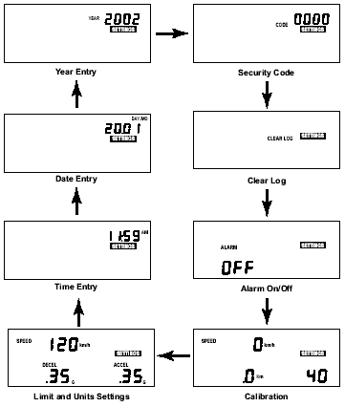
The Settings Screens
To access the settings screens, press and hold MODE while viewing any
of the data screens. After a few seconds, the Security Code screen will appear. To cycle through the settings screens (in the order shown below), press and release MODE.
NOTE: To view the data screens, press and hold MODE until the Current
Readings screen appears.

Slide 11
Calibration Using the Speedometer
In order to calibrate using the speedometer, you must drive steadily at 40 km/h (25 MPH) and press a button on the DriveRight 600. The DriveRight 600 bases its calibration on the speed of the vehicle at the moment of calibration which it assumes to be 40 km/h (25 MPH).
Because of the nature of this calibration procedure, we strongly recommend that it be performed by two people: one to drive the vehicle and one to operate the DriveRight 600.
NOTE: If you have entered a security code, you will need to enter that code before the DriveRight 600 will allow access to the calibration screen.

Slide 12
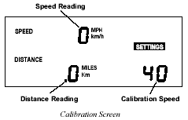
Calibration Using the Speedometer
1. Press and hold MODE to access the settings screens.
2. Press and release MODE until the Calibration screen appears. The calibration speed (40 or 25) appears at the bottom right of the display. The uncalibrated speed reading appears at the top of the display, along with the unit of measure (km/h or MPH).
Note that until you calibrate the DriveRight 600 this speed reading will be inaccurate. The distance, which appears in the lower left of the display, is not necessary for this calibration procedure

Slide 13
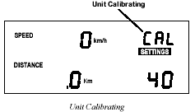
3. Drive the vehicle until you reach 40 km/h (25 MPH) and keep the vehicle steady at that speed.
4. Once the vehicle is moving steadily at the calibration speed, press and hold SET/CLEAR.
The word CAL appears in the top right of the display when you press
SET/CLEAR. This indicates that the unit is in the process of calibrating.

Slide 14
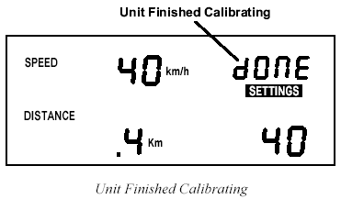
5. Continue to hold SET/CLEAR until the unit beeps and the word “DONE” appears on the display.
This indicates that the unit has finished calibrating. The speed reading at the top of the display will also change so that it reads much closer to your speedometer’s reading.
6. Once the calibration is complete, drive the vehicle and compare the vehicle’s speedometer to the DriveRight 600’s speed display. Be aware that the DriveRight 600 responds to changes in speed faster than most vehicles’ speedometers. To accurately compare, you must drive steadily at a speed for a short time.

Slide 15
7. If necessary, “fine tune” the calibration by pressing PLUS or
MINUS.
Each time you press PLUS or MINUS, the DriveRight 600 speed
reading adjusts up or down. Depending on the speed of the vehicle
and the calibration, you may or may not see a change in the speed
reading in the calibration screen each time you press the button.
NOTE: Pressing and holding PLUS or MINUS down increases the rate at which the DriveRight 600 adjusts the speed reading.
8. Continue to Press PLUS or MINUS until the DriveRight 600’s
speed reading agrees with your vehicle’s speedometer at a variety of speeds.
9. When finished calibrating, press and hold MODE until you return to the data screen.
When you finish fine-tuning, press MODE to exit the calibration
screen. All information will be automatically saved. Do not press and hold SET/CLEAR in an effort to save the fine-tuned calibration! If you press and hold SET/CLEAR, the unit completely resets the calibration number.

Slide 16
Calibration Using the Odometer
In order to calibrate using the odometer, you must compare a distance reading taken from your vehicle’s odometer to the DriveRight 600 and adjust the DriveRight 600 to match the vehicle’s odometer. Depending on how far you drive in order to calibrate the unit, this can result in an extremely accurate calibration.
NOTE: We recommend that you drive a minimum of 32km (20 miles)
when calibrating the unit.
Your vehicle’s speedometer and odometer may not be perfectly
linked. If they differ and you calibrate your DriveRight 600 using
the vehicle’s odometer, you may notice a discrepancy between the
DriveRight 600’s speed readings and the vehicle’s speedometer.
1. Obtain a rough calibration, using the speedometer as described in
“Calibration Using the Speedometer”
2. Reset your vehicle’s trip meter to zero or make a note of the
odometer reading.

Slide 17
3. Make sure you have a new trip started on the DriveRight 600 (i.e., the distance traveled is 0.
To forcibly start a new trip, log out.
4. Drive the vehicle for at least 32 km (20 miles).
The further you drive, the more accurate your calibration.
5. When you finish driving, compare your vehicle’s trip meter reading to the distance traveled reading on the DriveRight 600.
At this point, what you will need to do is increase or decrease the distance measured by the DriveRight 600 until it agrees with your vehicle’s odometer reading. This is accomplished from the calibration screen.
6. Press and hold MODE to access the settings screens.

Slide 18
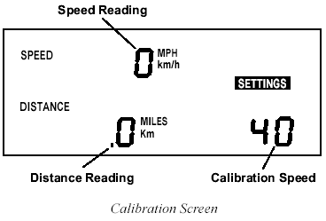
7. Press and release MODE until the Calibration screen appears.
The distance traveled appears at the lower left of the display. Note that until you calibrate the DriveRight 600, this distance reading will be inaccurate. The speed reading and calibration speed, which appear on the display as well, are not necessary for this calibration procedure.
8. Press PLUS or MINUS until the distance reading matches the trip meter on your vehicle.
Depending on how many miles you drove, you may need to press PLUS or MINUS several times before the distance reading changes.
NOTE: Pressing and holding PLUS/MINUS down increases the rate at which the DriveRight 600 adjusts the distance reading.

Slide 19
9. When finished calibrating, press and hold MODE until you return to the data screen.
Press MODE to exit the calibration screen. All information will be automatically saved. Do not press and hold SET/CLEAR in an effort to save the fine-tuned calibration! If you press and hold SET/CLEAR, the unit completely resets the calibration number.
DATA SCREENS
The following section explains all the information and options available in the various data screens. In addition to the options listed in the individual sections below, in every screen you have the following two options:
Move to the next Data Screen
Press and release MODE.
View the Settings Screens
Press and hold MODE.

Slide 20
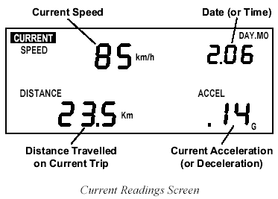
Current Readings Screen
The current readings screen displays constantly updating (as long as the car is moving) speed, distance (for the current trip), and acceleration/ deceleration readings (acceleration is positive, deceleration is negative). The current date (or time) is also displayed on this screen.
You have the following options from the Current Readings Screen:
Toggle Between Date and Time Display - To toggle between the two, press and release SET/CLEAR.
Change Units of Measure - To change the units of measure in which data is displayed from metric to U.S. units (or vice versa), press and hold SET/CLEAR for approximately 2 seconds. This does not change the date or time display format.

Slide 21
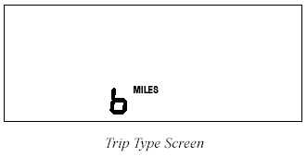
Specify Trip Type
There are four types of trips stored by the DriveRight 600: Business, Personal, Commute, and Other. The trip type is stored along with the rest of the trip information and is automatically saved when information is downloaded using the software.
NOTE: Although you may specify the type of trip using the DriveRight 600 display unit, you must have the software to view trip type information.
To change the type of trip, press and hold MINUS. The trip type screen will appear--do not release MINUS.
As long as you hold MINUS, the DriveRight 600 will cycle through the letters representing the various trip types: b = Business, P = Personal, C = Commute, O = Other. Release MINUS when the desired trip type appears.

Slide 22
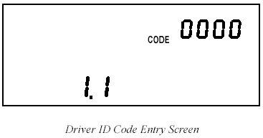
Driver ID Code Entry & Digital Input Status Screen
Turn Display Lamp On/Off
To turn the DriveRight 600’s display lamp on or off, press PLUS. You must be viewing the Current Readings Screen, the Trip Start/End Log screen, the Trip Speed and Distance Log screen or the Trip Accel/Decel Log screen to turn the display lamp on and off.
The Driver ID Code Entry Screen enables you to enter the driver ID code, displays the status of the two digital inputs, and also includes an activity indicator for the reed switch (GD and HD models) or VSS input (VSS and VF models).

Slide 23
Driver ID Code
When using the DriveRight 600 to monitor the driving of multiple drivers, assign each driver a unique 4-digit ID code. Before driving
the vehicle, the driver must enter his or her ID code. The DriveRight
600 stores the driver ID code with the rest of the trip information,
which enables you to view information for each individual driver.
In addition, data downloaded by the software is segregated by driver ID code, enabling detailed tracking of multiple drivers.
The DriveRight Vehicle Management Software allows you to use the
driver ID code to track locations instead when a single driver is using a vehicle. You may also use the software to turn on an alarm which will alert the driver when a driver ID (or location ID) has not been entered.
NOTE: Driver ID code 0000 (four zeros) is used to view information for the vehicle (all drivers) and should not be assigned to any driver, unless only a single driver uses the vehicle.

Slide 24
To view all information, regardless of driver ID code, enter the reserved code: 0000.
You have the following options from the Driver ID Code Entry Screen:
Enter a Driver ID Code - The flashing digit in the code is the active digit. Press and release PLUS or MINUS to cycle forward or backward through the available entries for the active digit (0 to 9). To change the digit which is active, press and release SET/CLEAR. Each time you press SET/CLEAR, the next digit become active.
If you have loaded driver ID codes into the DriveRight 600, then only those codes will be accepted. A “no” will appear on the screen if a wrong ID code is entered. A code of “0” will still be accepted.
Log Out - To “log out” press and hold SET/CLEAR for 2 seconds, until the code resets to 0000. As soon as a driver logs out, the current trip is ended and data for that trip stored in the DriveRight 600’s memory. Note that you may not log out when the vehicle is in motion.

Slide 25
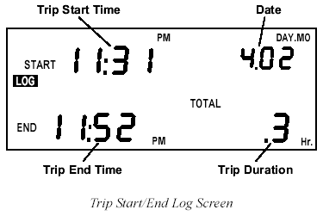
Trip Start/End Log Screen
The Trip Start/End Log Screen shows the start and end time for each trip currently stored in the DriveRight 600’s memory. To view trip times for a specific driver, enter that driver’s ID code in the Driver ID Code Entry screen. To view all trip times for the vehicle, enter ID code 0000.
NOTE: If the end time for a trip is “dashed,” it means that you are viewing the current trip, which has not yet ended (unless the unit was restarted in the middle of a trip).

Slide 26
Trip Speed and Distance Log Screen
The Trip Speed and Distance Log Screen shows the maximum speed, distance traveled, and amount of time spent driving over the set speed limit for each trip currently stored in the DriveRight 600’s memory.
To view trip speed and distance information for a specific driver, enter that driver’s ID code in the Driver ID Code Entry screen. To view all trip speed and distance information for the vehicle, enter ID code 0000.

Slide 27
Trip Acceleration/Deceleration Log Screen
The Trip Acceleration/Deceleration Log Screen shows the number of times the set acceleration and deceleration limits were exceeded during each trip currently stored in the DriveRight 600’s memory. (Each time the limit is exceeded, 1 “count” is recorded, regardless of the amount of time for which the limit was exceeded.)
To view trip acceleration/deceleration information for a specific driver, enter that driver’s ID code in the Driver ID Code Entry screen.
To view all trip acceleration/deceleration information for the vehicle, enter ID code 0000.

Slide 28
GPS Latitude and Longitude Position Screens
The GPS Position Screens alternate between Latitude and Longitude to show your current position, speed, and direction.
NOTE: The GPS screens are not displayed if the DriveRight is not
connected to a vehicle.
NOTE: The GPS may take up to several minutes to start tracking a
new trip, depending on the overhead obstructions surrounding the vehicle.

Slide 29
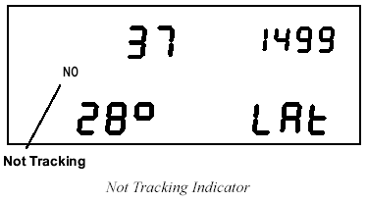
A “NO” on the Latitude and Longitude screens indicates the GPS module is not able to track your current position. The last known position will be displayed.

Slide 30
Odometer Screen
The Odometer screen displays the vehicle’s odometer reading which must be set from the DriveRight Vehicle Management Software. The odometer reading is spread across the two digit registers at the bottom of the screen and may ôake some getting used to (the odometer reading in the screen shown below is 5,812.2 km).
NOTE: The odometer readings is ALWAYS shown in the unit of measure in which it was entered. To change the unit of measure, you need to reenter the odometer reading using the software.

Slide 31
Limits Screen
The Limits screen enables you to view the set speed, acceleration, and deceleration limits for this DriveRight 600 unit. You may not change any of the limits from this screen; limits may only be changed from the Limits and Units Setting screen (see “Time Entry” on page 22), or using the DriveRight Vehicle Management Software. Acceleration and deceleration is measured in “G’s” (the gravitational constant which represents the acceleration of an object when falling to earth in a vacuum). 1G is roughly equal to an acceleration of 35 km/h (22 MPH) per second.

Slide 32
Settings Screens
The following section explains all the information and options available in the various settings screens. In addition to the options listed in the individual sections below, in every screen you have the following two options:
Move to the next Settings Screen - Press and release MODE.
View the Data Screens - Press and hold MODE.
Security Code Screen
If you are concerned about unauthorized changing of DriveRight 600 settings, you may enter a security code from the DriveRight or the software. After you have entered a security code, the DriveRight 600 will not allow access to the rest of the settings screens until the correct 4-digit security code is entered. The unit allows five attempts
to enter the correct security code before returning to the Current
Readings screen and activating the tamper indicator (pressing MODE to move to the next settings screen is considered an “attempt”). The time and date of the unsuccessful tamper attempt is stored and may be viewed using the DriveRight Fleet Management Software.

Slide 33
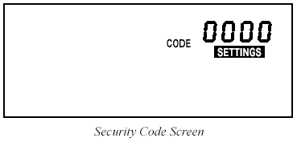
Security Code Screen
NOTE: Use security code 0000 (four zeros) if you do not want to password - protect calibration, since the unit defaults to that code when first displaying the Security Code screen.
You have the following options from the Security Code Screen:
Enter the Security Code - The flashing digit in the code is the active digit. Press and release PLUS or MINUS to cycle forward or backward through the available entries for the active digit (0 to 9). To change the active digit, press and release SET/CLEAR. Each time you press SET/CLEAR, the next digit becomes active. Once the correct security code has been entered, press MODE to move to the next settings screen.

Slide 34
NOTE: If the entered code is correct, the clear all log data screen appears when you press MODE. If the entered code is not correct, the word NO appears on the display. You may attempt to enter the correct code five times before the unit returns you to the Current Readings screen and activates the tamper indicator, if the tamper indicator is enabled.
Set or Change the Security Code
Use PLUS and MINUS to enter your current code (if you are entering a security code for the first time, make sure 0000 is entered). Press and hold SET/CLEAR until the word CHG (change) appears on the display.
Use PLUS and MINUS to enter the desired security code. When finished, press MODE to save the new code and move to the Clear Log Screen.

Slide 35
Clear Log Screen
The clear all log data screen allows you to perform a “total clear” function which erases all data for every trip in your log at once.
NOTE: Accident and tamper log data cannot be cleared.

Slide 36
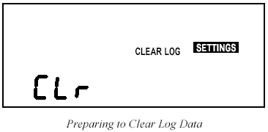
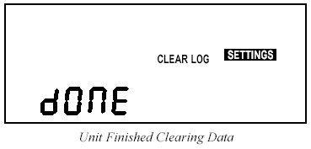
You have the following option from the Clear Log Screen:
Clear all Log Data - Press and hold SET/CLEAR. The word CLR (clear) appears in the display to indicate that the unit is preparing to clear all log data. To protect against accidental clearing of data, you must press and hold SET/CLEAR for 3 seconds before the unit clears data.
Continue to hold SET/CLEAR until the unit beeps and the word CLR disappears from the display. This indicates that the unit is in the process of clearing data. The unit beeps and the word dONE appears in the display when the unit finishes clearing data.

Slide 37
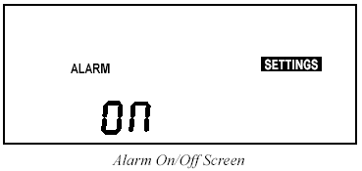
Alarm On/Off Screen
The Alarm On/Off screen enables you to toggle the DriveRight 600’s audible alarm on and off. When the alarm is on, the unit will beep when any of the set limits is exceeded, as a warning to the driver. Turning the alarm off will disable the beeping, though the DriveRight 600 will continue to record violations of the set limits.
You have the following option from the Alarm On/Off Screen:
Toggle the Alarm Setting - To toggle the alarm setting from On to Off (or vice versa), press and release SET/CLEAR. Each time you press SET/ CLEAR, the display changes to read ON or OFF, depending on the alarm’s status.

Slide 38
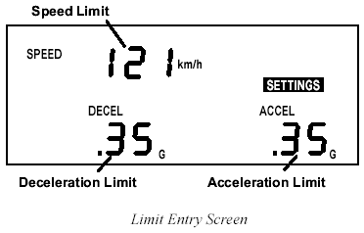
Calibration Screen
The Calibration screen enables you to calibrate the DriveRight 600 for your vehicle. See “Calibrating the DriveRight 600” on page 6 for
details.
Limit and Unit Settings Screen
The Limit and Unit Settings screen allows you to set limits for speed, acceleration, and deceleration. You may also change the unit of measure in which speed and distance information is displayed (km/h or MPH).

Slide 39
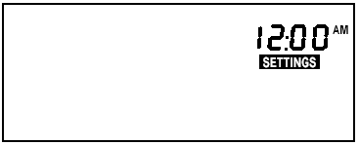
You have the following options from the Limit and Unit Settings Screen:
Enter/Change a Limit - Use SET/CLEAR to change the active digit and use PLUS and MINUS to enter the desired limit for speed, acceleration, and deceleration.
NOTE: The maximum limit settings are as follows: Speed 255, Acceleration and Deceleration 2.55.
Change the Unit of Measure - Press and release SET/CLEAR until the display segment (km/h or MPH) is flashing. Use PLUS and MINUS to toggle between km/h and MPH. Whatever segment is displayed when you press MODE to exit this screen is the unit of measure in which speed and distance information will be displayed.
Time Entry
The Time Entry screen allows you to set the time and to select the format (12 hour or 24 hour) in which you want time displayed.

Slide 40
You have the following options from the Time Entry Screen:
Set the Time - Use PLUS and MINUS to set the time. If you are displaying time in the 12 hour format, remember to choose either AM
or PM. To do this, follow the same procedure as if you were changing the format of the time display, as explained below.
Change the Time Display Format - Press and release SET/CLEAR until the PM, AM, or 24HR segment is flashing. Press PLUS to cycle through the three possible options: PM, AM, and 24HR. When the desired option appears in the display, stop. The segment displayed
when you press MODE to exit this screen sets the format in which time will be displayed.
NOTE: The unit will not automatically convert the time from 12 hour to 24 hour or vice versa. You must enter the time in the new format yourself.

Slide 41
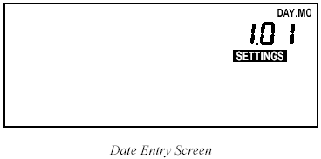
Date Entry
The Date Entry screen allows you to set the date and to select the
format (Day.Month or Month:Day) in which you want the date displayed.
You have the following options from the Date Entry Screen:
Set the Date - Use PLUS and MINUS to set the date.
Change the Time Display Format - Press and release SET/CLEAR until the Mo:Day or Day.Mo segment is flashing. Press PLUS to toggle between the two segments. When the desired format appears in the display, stop. The segment displayed when you press MODE to exit this screen sets the format in which the date will be displayed.

Slide 42
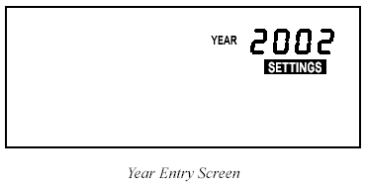
Year Entry
The Year Entry screen allows you to enter the correct year, which will allow the unit to automatically adjust for leap years.
You have the following option from the Year Entry Screen:
. Set the Year - Use PLUS and MINUS to set the Year.

Slide 43
MISCELLANEOUS INFORMATION
Accident Log - The DriveRight 600 has room in memory for 10 “accident” logs which show the vehicle‘s speed for the 20 seconds before and after a sudden deceleration. Information is written to the “accident” log any time the vehicle exceeds the unit’s set deceleration limit. Also, the last 20 seconds of trip information for each of the last 20 trips is saved in the accident log. The information in the accident log may be downloaded, viewed, printed, and stored using the DriveRight Fleet Management Software or the DriveRight Vehicle Management Software.
Tamper Log - The following actions will be logged as a tamper attempt:
. The DriveRight 600 is unplugged (loses power)
. Five incorrect entries in a row for the Security Code
. DriveRight is plugged back into the car (Tamper is logged but not displayed on the console)
. DriveRight is rebooted

Slide 44
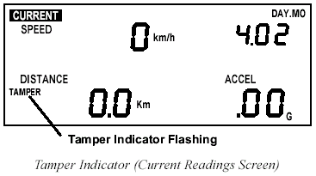
When a tamper is logged, the word “TAMPER” appears on all screens if the tamper light has been enabled using the software. Plus, the time at which the tamper attempt occurred and the cause of the tamper is stored in the tamper log. The last 10 tamper events can be downloaded, viewed and printed, using the DriveRight Vehicle Management Software.
To clear the flashing TAMPER segment, enter the correct security code (see “Security Code Screen”). The tamper indicator is also cleared after data is downloaded.
NOTE: All data in the DriveRight 600 is stored in “non-volatile” memory which means no data will be lost even if power is removed.

Slide 45
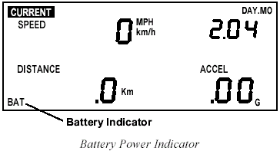
Battery Operation
The DriveRight 600 is designed to be taken out of your vehicle so the data may be reviewed anywhere. If you disconnect the unit from its power source (the vehicle) it will automatically switch to battery power. The word BAT appear in the lower left corner of all screens to indicate that you are running on battery power.
NOTE: If you notice that the LCD is fading when running on battery power, it means your battery power is low. You should replace your battery as soon as possible.

Slide 46
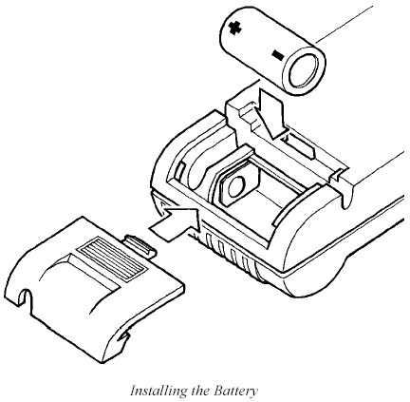
To install a new battery, insert the battery as shown below.
When operating under battery power, the unit will undergo a few changes in operation in order to conserve battery power:
If you go more than 5 minutes without pressing a button, the unit enters “sleep mode.”
In sleep mode, all but the most essential unit functions (that is, time and date) shut down. The display goes blank and no data is recorded when the unit is “asleep.”
NOTE: The unit never goes into sleep mode when connected to your vehicle (i.e., receiving power from your vehicle’s battery).
To “wake up” the unit, press MODE or reconnect the unit to your vehicle so it receives power from your vehicle’s battery.
The display lamp is disabled.
You cannot turn on the unit’s display lamp.

Slide 47
Battery Life
The GPS Latitude and Longitude position screen is not displayed.
The Latitude and Longitude screen will not appear when you scroll through the DriveRight 600 data screens.
When removed from a vehicle, the DriveRight unit taps into its own battery for power (instead of vehicle’s battery). On the unit’s battery alone, a unit will operate for 260 hours or, in sleep mode for 4 months. The life of the unit’s battery depends on your download schedule. For example, if you take the unit out of the vehicle 5 days a week, 8 hours a day, the unit’s battery can last up to 16 months. In that situation, because not all out-of-vehicle time will be spent in sleep mode and because of the occasional delay in returning the unit to the vehicle, we recommend replacing the battery every year. If at any time the LCD display begins dimming, the battery is low and due for replacement. If you plan to store a unit out-of-vehicle for more than a week, we recommend removing the battery. When you replace the battery, data and settings are not lost but you will need to reset the date and time.

Slide 48
Display Lamp
To read the DriveRight 600 at night, use the display lamp. To toggle the display lamp on and off, press PLUS when viewing the Current Readings screen. Be aware that the display lamp does not work when the unit is operating on battery power.
NOTE: The display lamp automatically shuts itself off after 10 minutes if the vehicle is stopped.
Restarting the DriveRight 600
If DriveRight 600 display “locks up,” you may restart the DriveRight
600 by pressing and releasing MODE and PLUS at the same time. No log data, settings, or code information is lost when you
restart the unit.
NOTE: The tamper indicator will appear if you restart the unit in this
way, if the tamper indicator light is set.
If the DriveRight 600 is still locked up, you must remove and reinsert
the battery and reset the time.

Slide 49
End of Presentation

